Slide 1
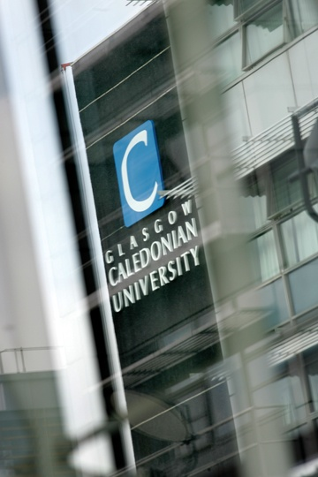
The power of the
collective
A keynote presentation at OER 2010 University of Cambridge, UK
by
Allison Littlejohn
Director, Caledonian Academy
Chair of Learning Technology
Shell Senior researcher
www.academy.gcal.ac.uk
Collaborators:
Dr Anoush Margaryan, Dr Colin Milligan, Helen Beetham, Lou McGill
Glasgow Caledonian University, UK

Slide 2
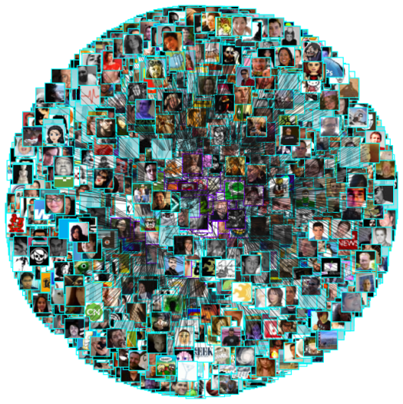
Paradigm shift
Paulson’s Law of Cooperative Freedom
Freedom for learners to negotiate the place, time, pace, content of learning as well as the technology and the media
Paulsen (1993)
Freedom to negotiate the type of relationship with other learners and teacher
Anderson (2006)

Slide 3
Paradigm shift
Smarter, simpler, social
The value of Social Software is its embedded economies of scope.
The ability for an asset to adapt to new uses (its environment) without large transaction costs.
Lee Bryant (Headshift, 2003)

Slide 4
Paradigm shift
Capetown declaration
Educators worldwide are developing a vast pool of educational resources, open and free for all to use.
Creating a world where each and every person on earth can access and contribute to the sum of all human knowledge.

Slide 5
Paradigm shift
Capetown declaration
Open educational resources and open technologies that facilitate collaborative, flexible learning and the open sharing of teaching practices that empower educators to benefit from the best ideas of their colleagues.
It may also grow to include new approaches to assessment, accreditation and collaborative learning
http://www.capetowndeclaration.org/read-the-declaration

Slide 6
Scenario 4
Paradigm shift
OER Programme Synthesis and Evaluation
Support to individual projects
Strand evaluation frameworks
Generic evaluation framework
OER snythesis and evaluation fundtion
Helen Beetham (14 subjects), Lou McGill (7 institutional)
Karen Smith/ Isobel Falconer (8 individual), Allison Littlejohn

Slide 7
Scenario 4
Paradigm shift
OER emerging business models:
Individuals
Tightly knit groups (eg topic communities)
Loosely connected networks (eg institutions)

Slide 8
Scenario 4
Paradigm shift
OER emerging business models (motivations):
Individuals
Commitment to open access, reputation enhancement, reward
Tightly knit groups (eg topic communities)
Sharing within group, sharing with The Many
Loosely connected networks (eg institutions)
Reputation building, ‘advertising’

Slide 9
Scenario 4
Paradigm shift
Individuals
Tightly knit groups, teams, communities
Loosely connected networks
Collectives
The Many/ The Multitude
Anderson and Dron, 2009; Sloep and Koper, 2009;
Hardt and Negri, 2006; Lave and Wenger

Slide 10
Charting collective knowledge
COLLECTIVE
KNOWLEDGE

Slide 11
Charting collective knowledge
Consume
COLLECTIVE
KNOWLEDGE

Slide 12
Charting collective knowledge
Consume
COLLECTIVE
KNOWLEDGE
Connect

Slide 13
Charting collective knowledge
Consume
COLLECTIVE
KNOWLEDGE
Create
Connect

Slide 14
Charting collective knowledge
Contribute
Consume
COLLECTIVE
KNOWLEDGE
Create
Connect

Slide 15
Charting collective knowledge
Contribute
Consume
COLLECTIVE
KNOWLEDGE
Create
Connect

Slide 16
Charting collective knowledge
Contribute
Consume
COLLECTIVE
KNOWLEDGE
Forethought – goal setting
Performance – goal implementation
Self-reflection – goal refinement
Create
Connect

Slide 17
Charting collective knowledge
Contribute
Consume
CHARTING
Forethought – goal setting
Performance – goal implementation
Self-reflection – goal refinement
Create
Connect

Slide 18
Charting collective knowledge
Consume
Connect
Create
Contribute
The
Individual
Their
Goals
Groups, Networks
and the Collective
Notes:
18

Slide 19
You
Your
goal
Notes:
19

Slide 20
You
Your
goal
Formal Learning
Libraries of Cases / Examples of Practice
Dynamic Knowledge, e.g. wikis
Knowledge Networks
Collaborative Spaces
Smart Information
Your Knowledge
Shared resources (e.g. delicious)
Recommended Resources
Notes:
20

Slide 21
Anyone
Colleagues with similar skills
Team
Peers with similar goals
Manager
You
External contacts
You
Your
goal
Formal Learning
Libraries of Cases / Examples of Practice
Dynamic Knowledge, e.g. wikis
Knowledge Networks
Collaborative Spaces
Smart Information
Your Knowledge
Shared resources (e.g. delicious)
Recommended Resources
Notes:
21

Slide 22
GROUP
Anyone
Colleagues with similar skills
Team
Peers with similar goals
Manager
You
External contacts
You
Your
goal
Formal Learning
Libraries of Cases / Examples of Practice
Dynamic Knowledge, e.g. wikis
Knowledge Networks
Collaborative Spaces
Smart Information
Your Knowledge
Shared resources (e.g. delicious)
Recommended Resources
Notes:
22

Slide 23
GROUP
NETWORK
Anyone
Colleagues with similar skills
Team
Peers with similar goals
Manager
You
External contacts
You
Your
goal
Formal Learning
Libraries of Cases / Examples of Practice
Dynamic Knowledge, e.g. wikis
Knowledge Networks
Collaborative Spaces
Smart Information
Your Knowledge
Shared resources (e.g. delicious)
Recommended Resources
Notes:
23

Slide 24
GROUP
NETWORK
Anyone
Colleagues with similar skills
Team
Peers with similar goals
Manager
You
External contacts
You
Your
goal
Formal Learning
Libraries of Cases / Examples of Practice
Dynamic Knowledge, e.g. wikis
Knowledge Networks
Collaborative Spaces
Smart Information
Your Knowledge
Shared resources (e.g. delicious)
Recommended Resources
COLLECTIVE
Notes:
24

Slide 25
Anyone
Colleagues with similar skills
Team
Peers with similar goals
Manager
You
External contacts
You
CONSUME
Your
goal
Formal Learning
Libraries of Cases / Examples of Practice
Dynamic Knowledge, e.g. wikis
Knowledge Networks
Collaborative Spaces
Smart Information
Your Knowledge
Shared resources (e.g. delicious)
Recommended Resources
Notes:
25

Slide 26
Anyone
Colleagues with similar skills
Team
Peers with similar goals
CONNECT
Manager
You
External contacts
You
CONSUME
Your
goal
Formal Learning
Libraries of Cases / Examples of Practice
Dynamic Knowledge, e.g. wikis
Knowledge Networks
Collaborative Spaces
Smart Information
Your Knowledge
Shared resources (e.g. delicious)
Recommended Resources
Notes:
26

Slide 27
Anyone
Colleagues with similar skills
Team
Peers with similar goals
CONNECT
Manager
You
External contacts
CREATE
You
CONSUME
Your
goal
Formal Learning
Libraries of Cases / Examples of Practice
Dynamic Knowledge, e.g. wikis
Knowledge Networks
Collaborative Spaces
Smart Information
Your Knowledge
Shared resources (e.g. delicious)
Recommended Resources
Notes:
27

Slide 28
Anyone
Colleagues with similar skills
Team
Peers with similar goals
CONNECT
CONNECT
Manager
You
External contacts
CREATE
You
CONSUME
Your
goal
CONTRIBUTE
Formal Learning
Libraries of Cases / Examples of Practice
Dynamic Knowledge, e.g. wikis
Knowledge Networks
Collaborative Spaces
Smart Information
Your Knowledge
Shared resources (e.g. delicious)
Recommended Resources
Notes:
28

Slide 29
Anyone
Colleagues with similar skills
Team
Peers with similar goals
CONNECT
CONNECT
Manager
You
External contacts
CREATE
You and Your Peers
CONSUME
Your
goals
CONTRIBUTE
Formal Learning
Libraries of Cases / Examples of Practice
Dynamic Knowledge, e.g. wikis
Knowledge Networks
Collaborative Spaces
Smart Information
Your Knowledge
Shared resources (e.g. delicious)
Recommended Resources
Notes:
29

Slide 30
Anyone
Colleagues with similar skills
Team
Peers with similar goals
CONNECT
CONNECT
Manager
You
External contacts
CREATE
You and Your Peers
CONSUME
Your
goals
CONTRIBUTE
Formal Learning
Libraries of Cases / Examples of Practice
Dynamic Knowledge, e.g. wikis
Knowledge Networks
Collaborative Spaces
Smart Information
Your Knowledge
Shared resources (e.g. delicious)
Recommended Resources
Notes:
30

Slide 31
How do we support the achievement of goals?
MY GOALS
ME
Notes:
Charting occurs at a level above connection, consumption, creation and contribution. The key to charting is the ability of the learner or employee to define her learning goals.

Slide 32
The Ideal?
MY GOALS
Everything you do contributes towards achieving your goals.
Actually, this is too simplistic
ME
Notes:
To maximise the speed with which an individual will learn, the ideal situation is where everything this individual will contribute towards her learning. In other words, an employee carrying out a job will learn through her normal work tasks. Learning is aligned with her work tasks, knowledge creation and knowledge sharing. This direct route to achieving leaning goals allows for maximum learning productivity.

Slide 33
The Ideal (2)
MY GOALS
Not every activity contributes towards achieving your goals and you will periodically assess and refine your effort.
ME
Notes:
In reality not everything an employee or learner does will directly contribute to achieving her learning goals – the route is more likely to swerve. In formal learning setting goals are well defines, but in workplace or informal learning goals are loosely defined. Setting goals is not as linear as in formal education.

Slide 34
The Reality
MY GOALS
MY GOALS
Goals may actually evolve over time.
ME
Notes:
Learning goals may alter over time. A learner may not be able to predict from the outset where her emerging goals will lead her.

Slide 35
Charting
MY GOALS
Helps you relate where you are to where you started and where you want to be.
ME
Notes:
Charting helps the learner relate where she is to where she wants to be – and will help her find how to get there by recommending existing trails used by previous learners following a similar route

Slide 36
Charting (2)
MY GOALS
Helps you relate where you are to where you started and where you want to be
… over and over …
providing the opportunity to dynamically interact with your goals and personal development.
ME
Notes:
Charting provides the learner opportunity to dynamically interact with her goals and personal development

Slide 37
Charting (3)
MY GOALS
Useful resources,
Useful people
Charting presents an opportunity to make use of people and resources to fine tune your plans at each point.
ME
Notes:
Charting allows the learner to make use of people and resources to fine tune her choices at any point. We cannot exactly define charting prior to looking at existing behaviours.
With TUG we developed a series of scenarios and use cases on the basis of our empirical study.
We have also started developing, in collaboration with colleagues at the Technical University of Graz in Austria, initial mock ups to help use refine our thinking around some of the functionalities of a potential charting system.
I will quickly show you some of these mockups, which I admit are rather ugly at the moment, but hopefully will give you the idea of where we are heading with this.

Slide 38
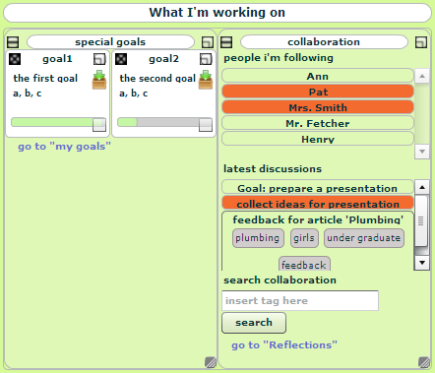
Charting mock ups – *very* early conceptualisations
Notes:
This view represents an element of a charting system that can be implemented as two Netvibes widgets sitting side by side.
The left hand one is essentially a quick drop box for files and resources - when you have a new resource, you can drop it on the relevant goal and it comes into the system, perhaps gaining tags automatically, being automatically forwarded to other people sharing that goal with you and so on.
The right hand side would be a second widget giving access to people in your network.

Slide 39
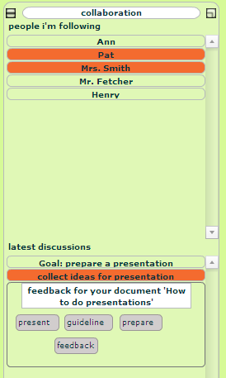
Charting mock ups – *very* early conceptualisations
Notes:
Here is the people widget expanded a little bit.
If you click on the name you would see simple contact details, but primarily, the nameplate would act as a space to drop resources on.
The recipient would then be alerted that a new resource was available for them.
Below that, there is a space for recent conversations, which may by synchronous or asynchronous, and for which there may be resources attached.
Each discussion may change colour when there is new activity.
With the upcoming launch of Google Wave it is interesting to think about how all of this could be done using the Wave.
For the people, another option is that when you click on their name you are taken to the persons blog, which would have a charting widget showing a public view of their charting (current goals, recent resources) as a sidebar.

Slide 40
And finally... new challenges identified by Malcolm
Benefits to learning processes from OERs
How might learners self regulate their learning within groups, networks and collectives?
Focus on the discovery and use of OERs
How might individuals draw from and contribute to the collective knowledge?
Supporting the needs of the sector
What new business models might universities adopt?
Learn from the experiences of the pilots
How can we encourage individuals (learners, teachers, support staff) to change behaviours?

Slide 41
The power of the
collective
Allison Littlejohn
Director, Caledonian Academy
Chair of Learning Technology
Shell Senior researcher
www.academy.gcal.ac.uk
Collaborators:
Dr Anoush Margaryan, Dr Colin Milligan, Helen Beetham, Lou McGill
Glasgow Caledonian University, UK

Slide 42
Paradigm shift from | .....to...
We know, we teach you | Learners' digital skills rewarded and used as a resource for the learning community/group/collective
Stable job market in specific vocations and professions | Unstable job market: adaptability management of multiple roles to the fore
Students typically on two- or three-year programmes of study: | Students engaged in multiple forms of learning while employed /or attending several institutions
Established methods, based in disciplines | Emerging and mixed methods, interdisciplinary problem spaces
Students become 'qualified' in specific kinds of academic knowledge practice | Students need to strategically manage a range of knowledge practices, for different contexts
Technologies are introduced according to the requirements of the curriculum | Curriculum is continually modified by the impacts of technology in the environment
Modular assessment: focus on achievement within clearly defined curriculum goals | Some cross-modular assessment: focus on self-efficacy and the ability to integrate skills/know-how
Disaggregated services(library, ICT, study skills, careers) | Integrated support for students' learning development and different learning pathways
Induction and one-off training model of literacy support | Ongoing review, progression and just-in-time support

Slide 43
Scenario 4
Social practices
To function effectively within these practices, learners must develop literacies to be able to:
operate in ill-defined, non-hierarchical environments;
work within expanding geographical and time horizons;
collaborate across diverse and distributed groups, networks and collectives
Learning Literacies in the Digital Age (LLiDA)
Paper by Beetham et al presented at LiDU seminar series, March2010

Slide 44
Scenario 4
Social practices
Learners can be confident about using the internet yet lack critical capabilities, and research skills JISC 'learners experiences of e-learning'
Learners often have little idea how to use tools to support their learning
HEA Learning from Digital Natives, Margaryan et al, 2009
Some advanced learners are not using ICT for learning tasks Hardy et al 2009
There is no evidence of widespread and universal disaffection, or of a distinctly different “learning style the like of which has never been seen before” Bennett et al, 2008
Tutor guidance is a critical determinant of technology-based learning practices adopted by learners Goodfellow & Lea, 2009

Slide 45
Scenario 4
Social practices
In practice - little evidence of learners acquiring literacies through situated, social practice
Some aspects of learners' everyday practices with technology are at odds with the practices valued in formal teaching and assessment
(Beetham 2009)
Requires the right conditions to enable individuals to set and attaining their learning goals by drawing from and contributing to collective knowledge
Beetham, McGill, Littlejohn (Learning Literacies for the Digital Age, LLiDA, 2009)

